Slide 1
Lecture 06
Persuasive message

Slide 2
Indirectness in persuasive messages
Everything you write on the job will have some kind of persuasive purpose—to convince the reader of your professionalism, convey an appealing company image, promote good relations, and the like.
Because you will be proposing something that your reader probably does not already agree with or want to do, it is often best to organize persuasive messages in an indirect order.
Ideally, you should organize each persuasive message so that, from the title or subject line to the end, your readers will agree with you.

Slide 3
General advice about persuasion
Know Your Readers For any kind of persuasive message - thinking about your subject from your readers’ point of view is critical.
To know what kind of appeals will succeed with your readers, you need to know as much as you can about their values, interests, and needs.
No one is persuaded to do something for no reason.
Sometimes their reasons for acting are related to tangible or measurable rewards.

Slide 4
General advice about persuasion
For example, they will save money, save time, or acquire some kind of desired object.
But often, the rewards that persuade are intangible. People may want to make their lives easier, gain prestige, or have more freedom.
Or perhaps they want to identify with a larger cause, feel that they are helping others, or do the right thing.

Slide 5
General advice about persuasion
Prefer intrinsic benefit over extrinsic benefit - Intrinsic benefit are benefit that readers will get automatically by complying with your request.
For example, if you are trying to persuade people to attend your company’s awards dinner, the pleasure of sharing in their colleagues’ successes will be intrinsic to the event.
Door prizes would be an extrinsic benefit.

Slide 6
General advice about persuasion
Turn your product features into reader benefit
If you say that a wireless service uses a certain kind of technology, you’re describing a feature.
If you say that the technology results in fewer missed or dropped calls, you’re describing a benefit.
Benefit persuade by enabling readers to envision the features of the recommended product or action in their own worlds.

Slide 7
General advice about persuasion
Use scenario painting to help readers visualize themselves enjoying the benefits of the product.
Here is an example of scenario painting from the Carnival Cruise Lines website:
Think your schedule is too tight to take a fun-filled vacation? Our Baja Mexico sailings are just the cruises to change your mind. You can experience the tropical beauty of Baja with a 3-day weekend cruise to Ensenada. Relax in the privacy of Ensenada’s private beaches before hitting the fashionable shops of Avenida Primera for new jewelry—duty-free, of course.

Slide 8
General advice about persuasion
Have an extra day to spare? Our 4-day Baja cruises visit Catalina Island. Who knows? You may spot some of Hollywood’s elite while sunning on the golden beaches of California’s Emerald Island.

Slide 9
The three kinds of appeal
Aristotle identified three kinds of persuasive appeals: logic based, emotion based, and character based.
As the writer of a persuasive message, you will need to think especially carefully about how to manage these appeals and which ones to emphasize given your intended audience
Think of each of the appeals in turn - What kind of logical appeals might you use—saved money? Saved time? A more dependable or effective product?
How about emotional appeals? Higher status? Increased popularity?

Slide 10
The three kinds of appeal
And don’t neglect appeals based on character. What kind of image of yourself and your company will resonate with the reader? Should you get a celebrity or expert to endorse your product or to serve as the spokesperson?
Not only when planning but also when revising your persuasive message, assess your appeals. Be sure to choose and develop the ones most likely to persuade your audience.

Slide 11
The three kinds of appeal
And don’t neglect appeals based on character. What kind of image of yourself and your company will resonate with the reader? Should you get a celebrity or expert to endorse your product or to serve as the spokesperson?
Not only when planning but also when revising your persuasive message, assess your appeals. Be sure to choose and develop the ones most likely to persuade your audience.

Slide 12
Make it easy to comply
Making the desired action specific and easy to perform is a key part of moving your readers from resistance to compliance with your request.
For example, If you want people to give money or buy your product, tell them where and how to do it, and supply a preaddressed mailing envelope or a web address if applicable.
Or, if you want employees to give suggestions for improving products or operations, tell them exactly where and how to submit their ideas and make it easy for them to do so.

Slide 13
The General Plan

Slide 14
General plan
Gaining attention in the opening
The opening sets up the strategy and gains attention.
It should make the reader receptive to your message
An effective attention getter is both creative and adapted to your reader.
For example - From the cover letter of a questionnaire seeking the opinions of medical doctors:
What, in your opinion as a medical doctor, is the future of the private practice of medicine?

Slide 15
General plan
Gaining attention in the opening (continued)
From a message requesting contributions for orphaned children: While you and I dined heartily last night, 31 orphans at San Pablo Mission had only dried beans to eat.
If writing your request in the form of a problem–solution message, you should start with a goal that you and the readers share.

Slide 16
General plan
Gaining attention in the opening (continued)
For example -
let’s say that a project manager in your company has retired and that, as one of your company’s executive committee, you want a certain member of the office staff to be promoted into the position.
The challenge is that no office person in your company has ever broken into the managerial ranks, so any direct proposal to promote your candidate will, you feel sure, be met with this objection.

Slide 17
General plan
Gaining attention in the opening (continued)
To get readers on your side from the beginning, you could start your message with facts that everyone can agree upon: that someone has retired, that their duties are important, that someone capable needs to be found, and fast.
Your subject line for an email along these lines might be something like, “Reassigning Jim Martin’s Duties” (which everyone supports), not “Promoting Kathy Pearson” (which your readers will resist unless you have prepared them for the idea).

Slide 18
General plan
Developing the appeal
Following the opening, you should proceed with your goal of persuading.
Your task here is a logical and orderly presentation of the reasoning you have selected.
Don't merely list points. Convey the ponts with convincing details.
Since you are trying to penetrate a neutral or resistant mind, you need to make good use of the you viewpoint.

Slide 19
General plan
Developing the appeal (continued)
You need to pay careful attention to the meanings of your words and the clarity of your expression.
You need to use logic and emotion appropriately and project an appealing image.
And, because your reader may become impatient if you delay your objective, you need to make every word count.
Make the Request Clearly and Positively - Don't use a negative tone. Ending with a reminder of the appeal is also good.

Slide 20
Contrasting examples

Slide 21
Scenario
Introduce yourself to the next business message situation by returning to your hypothetical position at Pinnacle.
As a potential executive, you spend some time working for the community. Pinnacle wants you to do this volunteer work for the sake of good public relations.
You want to do it because it is personally rewarding. Currently, as chair of the fund-raising committee of the city’s Junior Achievement program, you head all efforts to get financial support for the program from local businesspeople.

Slide 22
Scenario
You have a group of workers who will call on businesspeople. But personal calls take time, and there are many people to call on.
At its meeting today, the Junior Achievement board of directors discussed the problem of contacting businesspeople. One director suggested using a letter to sell them on giving money. The board accepted the idea with enthusiasm.
With just as much enthusiasm, it gave you the assignment of writing the letter.

Slide 23
Scenario
As you view the assignment, it is not a routine letter-writing problem.
Although the local businesspeople are probably generous, they are not likely to part with money without good reason.
In fact, their first reaction to a request for money is likely to be negative. So you will need to overcome their resistance in order to persuade them.
Your task is indeed challenging.

Slide 24
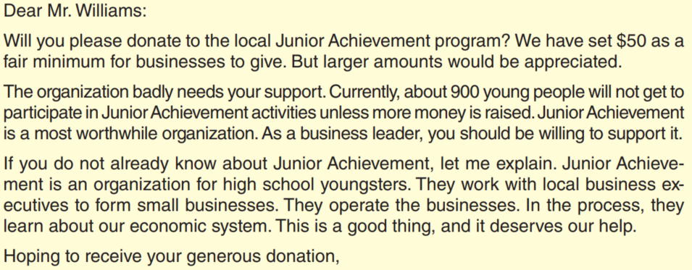
The bad approach

Slide 25
The bad approach
The weak letter begins with the request. Because the request is opposed to the reader’s wishes, the direct beginning is likely to get a negative reaction.
In addition, the comments about how much to give tend to lecture rather than suggest. Some explanation follows, but it is weak and scant.
In general, the letter is poorly written. It makes little use of the you-viewpoint. Perhaps its greatest fault is that the persuasion comes too late. The selfish close is a weak reminder of the action requested.

Slide 26
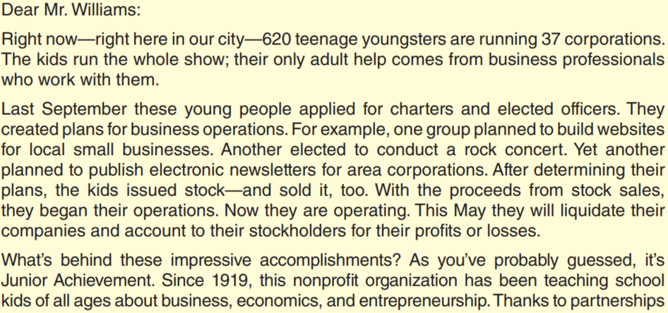
The good approach
The weak letter begins with the request. Because the request is opposed to the reader’s wishes, the direct beginning is likely to get a negative reaction.
In addition, the comments about how much to give tend to lecture rather than suggest. Some explanation follows, but it is weak and scant.
In general, the letter is poorly written. It makes little use of the you-viewpoint. Perhaps its greatest fault is that the persuasion comes too late. The selfish close is a weak reminder of the action requested.

Slide 27
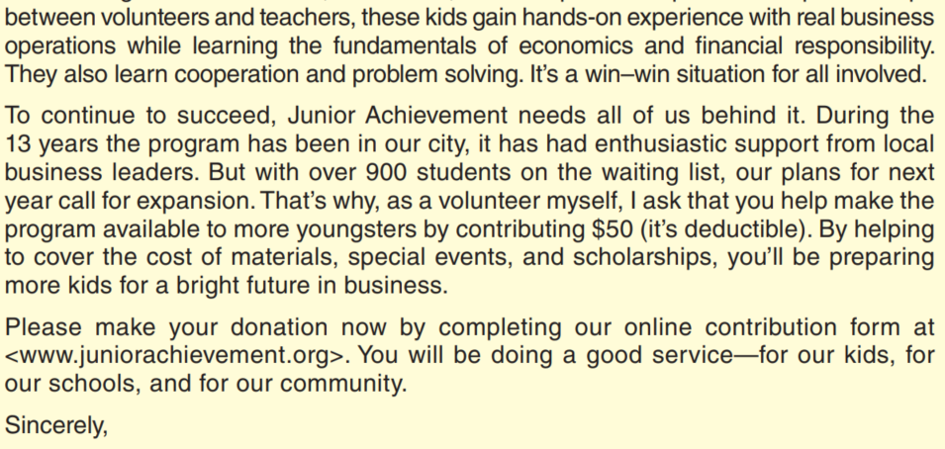
The good approach
The weak letter begins with the request. Because the request is opposed to the reader’s wishes, the direct beginning is likely to get a negative reaction.
In addition, the comments about how much to give tend to lecture rather than suggest. Some explanation follows, but it is weak and scant.
In general, the letter is poorly written. It makes little use of the you-viewpoint. Perhaps its greatest fault is that the persuasion comes too late. The selfish close is a weak reminder of the action requested.

Slide 28
The good approach
Skillful Persuasion in An Indirect Order - Its opening generates interest and sets up the persuasion strategy.
Notice the effective use of the you-viewpoint throughout. Not until the reader has been sold on the merits of the request does the message ask the question.
It does this clearly and directly. The final words leave the reader thinking about the benefit that a yes answer will give.

Slide 29
Sales message

Slide 30
Sales message
Appeals for sales message maybe emotional, rational, or character based.
Illustrating emotional appeal is the following example from a message that attempts to sell perfume by linking the romance of faraway places with the product’s exotic scent:
Linger in castle corridors on court nights in London. Dance on a Budapest balcony high above the blue Danube. Seek romance and youth and laughter in charming capitals on five continents. And there you’ll find the beguiling perfume that is fragrance Jamais.

Slide 31
Sales message
Logical appeals are more rational. These include strategies based on saving money, making money, doing a job better, and getting better use from a product.
Illustrating a rational appeal (saving money) are these words from a message selling magazine subscriptions:
We’re slashing the regular rate of $36 a year down to only $28, saving you a full 22 percent. That means you get 12 information-filled new issues of Science Digest for only $2.33 a copy. You save even more by subscribing for 2 or 3 years.

Slide 32
Sales message
Appeals based on character persuade by implying such arguments as “I use this product, so you should, too” or “I am an authority, so you should do what I recommend.”
Ads that employ sports figures, film stars, or experts to sell their products are relying heavily on character-based appeals.
Companies themselves can often take on an appealing “character” in their sales campaigns.

Slide 33
Sales message
Note how the following excerpt from a sales letter for Consumer Reports magazine uses the company’s identity to persuade:
Consumer Reports is on your side. We’re a nonprofit consumer protection organization with no commercial interests whatsoever. To put it bluntly, we don’t sell out to big companies and private interest groups—we’re accountable to no one except to consumers. And when you’re not beholden to advertisers (like other so-called consumer protection publications), you can tell it like it is.

Slide 34
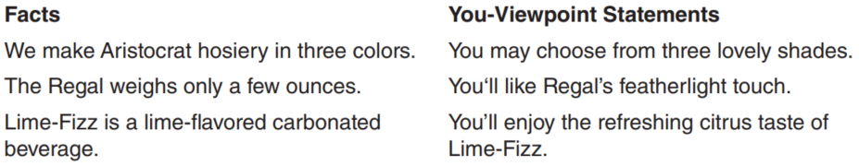
Stressing the you-viewpoint
In no area of business communication is the use of the you-viewpoint more important than in sales writing.
A successful sales message bases its sales points on reader interest. You should liberally use and imply the pronoun you throughout the sales message as you present your well-chosen reader benefits.

Slide 35
Contrasting examples

Slide 36
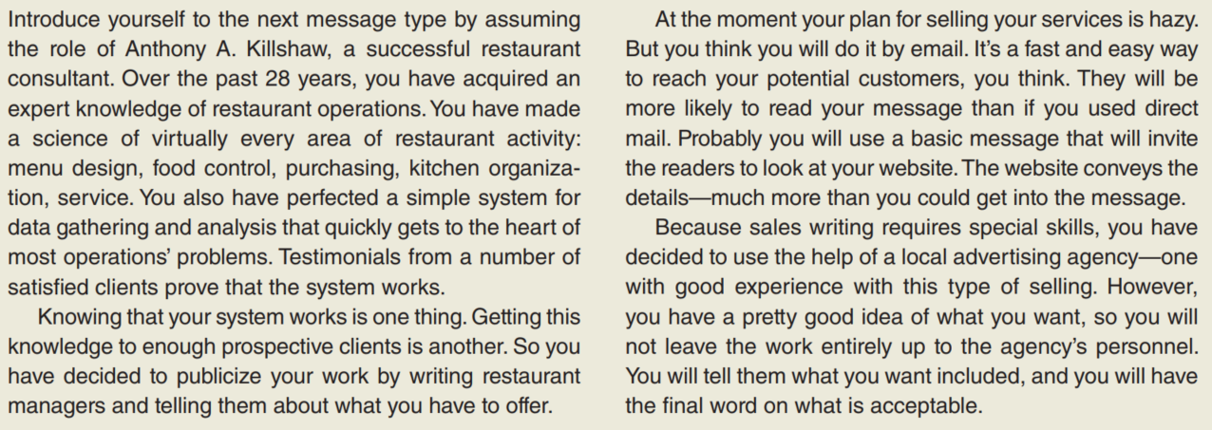
Scenario
In no area of business communication is the use of the you-viewpoint more important than in sales writing.
A successful sales message bases its sales points on reader interest. You should liberally use and imply the pronoun you throughout the sales message as you present your well-chosen reader benefits.

Slide 37
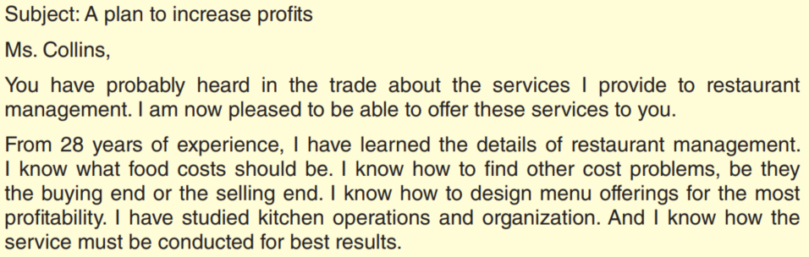
The bad example
In no area of business communication is the use of the you-viewpoint more important than in sales writing.
A successful sales message bases its sales points on reader interest. You should liberally use and imply the pronoun you throughout the sales message as you present your well-chosen reader benefits.

Slide 38
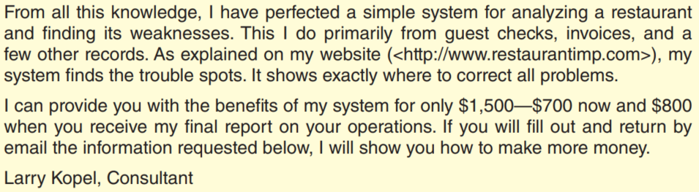
The bad example
In no area of business communication is the use of the you-viewpoint more important than in sales writing.
A successful sales message bases its sales points on reader interest. You should liberally use and imply the pronoun you throughout the sales message as you present your well-chosen reader benefits.

Slide 39
The bad example
Weakness in An Illogical Plan - Although the subject line of the amateur’s sales message presents the main appeal, it is dull and general.
The opening statement is little more than an announcement of what the consultant does. Then, as a continuation of the opening, it offers the services to the reader. Such openings do little to gain attention or build desire.
Next comes a routine, I-viewpoint review of the consultant’s services. The explanation of the specific services offered is little better. Although the message tells what the consultant can do, it is dull. The drive for action is more a hint than a request. The closing words do suggest a benefit for the reader, but the effort is too little too late.

Slide 40
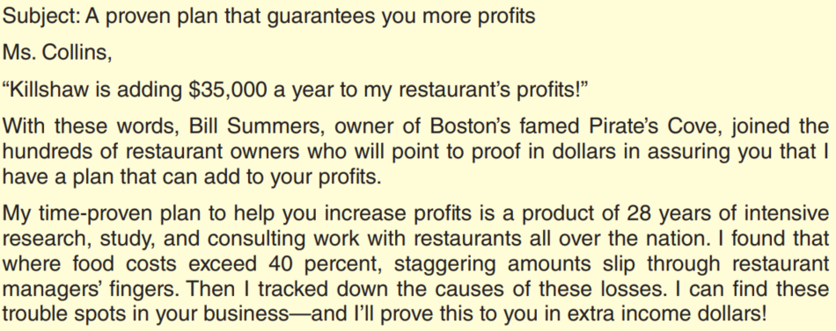
The good example
Weakness in An Illogical Plan - Although the subject line of the amateur’s sales message presents the main appeal, it is dull and general.
The opening statement is little more than an announcement of what the consultant does. Then, as a continuation of the opening, it offers the services to the reader. Such openings do little to gain attention or build desire.
Next comes a routine, I-viewpoint review of the consultant’s services. The explanation of the specific services offered is little better. Although the message tells what the consultant can do, it is dull. The drive for action is more a hint than a request. The closing words do suggest a benefit for the reader, but the effort is too little too late.

Slide 41
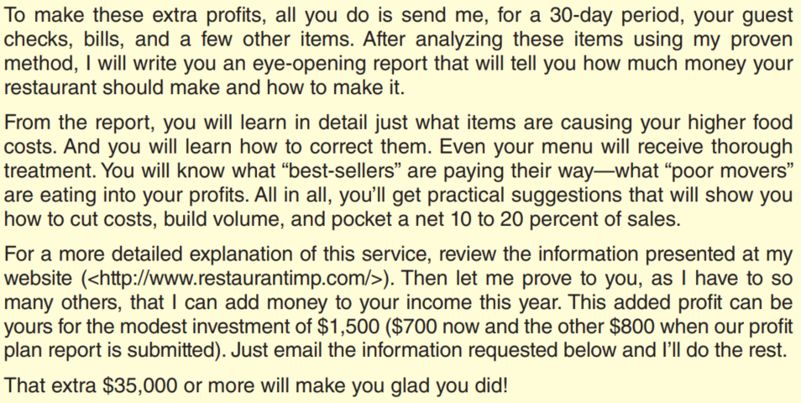
The good example
Weakness in An Illogical Plan - Although the subject line of the amateur’s sales message presents the main appeal, it is dull and general.
The opening statement is little more than an announcement of what the consultant does. Then, as a continuation of the opening, it offers the services to the reader. Such openings do little to gain attention or build desire.
Next comes a routine, I-viewpoint review of the consultant’s services. The explanation of the specific services offered is little better. Although the message tells what the consultant can do, it is dull. The drive for action is more a hint than a request. The closing words do suggest a benefit for the reader, but the effort is too little too late.

Slide 42
Discussion & debate

Slide 43
Discussion & debate
Assume that, as a volunteer for a nonprofit organization in your town, you have been asked to write the next fundraising letter for the organization. In what ways might you gather enough information about the intended readers to write a successful message?
List the tangible and intangible benefit that you might describe when promoting the following items or services: a. Membership in a health club. b. High-speed Internet service or digital cable service. c. A certain line of clothing .

Slide 44
Discussion & debate
List some extrinsic benefit you might use as an extra push if you were promoting the items in number 2.
For each item in number 2, list two likely product features and then turn them into reader benefit.
Choose one of the items in number 2 and write a paragraph that uses scenario painting to promote the item.

Slide 45
Discussion & debate
Criticize the persuasive request message below.
It was written by the membership chairperson of a chapter of the Service Corps of Retired Executives (SCORE), a service organization consisting of retired executives who donate their managerial talents to small businesses in the area.
The recipients of the message are recently retired executives.

Slide 46
Discussion & debate
Dear Ms. Petersen: As membership chair it is my privilege to invite you to join the Bay City chapter of the Service Corps of Retired Executives. We need you, and you need us.
We are a volunteer, not-for-profit organization. We are retired business executives who give free advice and assistance to struggling small businesses. There is a great demand for our services in Bay City, which is why we are conducting this special membership drive. As I said before, we need you. The work is hard and the hours can be long, but it is satisfying.

Slide 47
Discussion & debate
Please find enclosed a self-addressed envelope and a membership card. Fill out the card and return it to me in the envelope. We meet the first Monday of every month (8:30 at the Chamber of Commerce office). This is the fun part—strictly social. A lot of nice people belong.
I’ll see you there Monday!
Sincerely yours,

Slide 48
Discussion & debate
Evaluate the following sales message. It was written to people on a mailing list of fishing enthusiasts. The writer, a professional game fisher, is selling his book by direct mail. The nature of the book is evident from the letter.
Have you ever wondered
why the pros catch fish
and you can’t?
They have secrets. I am a pro, and I know these secrets. I have written them and published them in my book, The Bible of Fishing.

Slide 49
Discussion & debate
This 240-page book sells for only $29.95, including shipping costs, and it is worth every penny of the price. It tells where to fish in all kinds of weather and how the seasons affect fishing. It tells about which lures to use under every condition. I describe how to improve casting and how to set the hook and reel them in. There is even a chapter on night fishing.
I have personally fished just about every lake and stream in this area for over forty years and I tell the secrets of each. I have one chapter on how to find fish without expensive fish-finding equipment. In the book I also explain how to

Slide 50
Discussion & debate
determine how deep to fish and how water temperature affects where the fish are. I also have a chapter on selecting the contents of your tackle box.
The book also has an extensive appendix. Included in it is a description of all the game fish in the area—with color photographs. Also in the appendix is a glossary that covers the most common lures, rods, reels, and other fishing equipment.

Slide 51
Discussion & debate
The book lives up to its name. It is a bible for fishing. You must have it! Fill out the enclosed card and send it to me in the enclosed stamped and addressed envelope. Include your check for $29.95 (no cash or credit cards, please). Do it today!
Sincerely yours,

Slide 52
Thank you!

